Slide 1
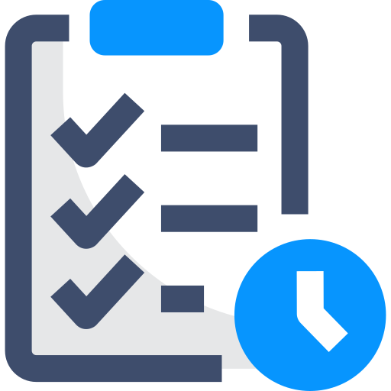
TO-DO Tracker
Presented By:
Shashank Malviya
Tamojit Das
Sai Saranya
Mentor:
Mr. Rakesh Pandit

Slide 2
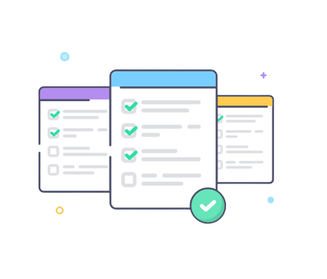

About TO-DO Tracker
Captures quick ideas, add notes, check tasks off your To-Do list.
One of the fundamental features for any productivity tool is a To-Do list. With the To-Do Tracker, you can create and share notes and lists.
To-Do Tracker surfaces the right tasks at the right time, so you always know what to focus on next.

Slide 3
Features of our Project
User can create as many to-do he/she wishes to, categorize and organize your tasks.
1
Get reminded about self-imposed deadlines.
2
Mark the tasks as completed. Modify/Update and remove the tasks from list as required.
3
List the archived tasks as and when required.
4
Offers user friendly interface.
5

Slide 4















Technologies used

Slide 5
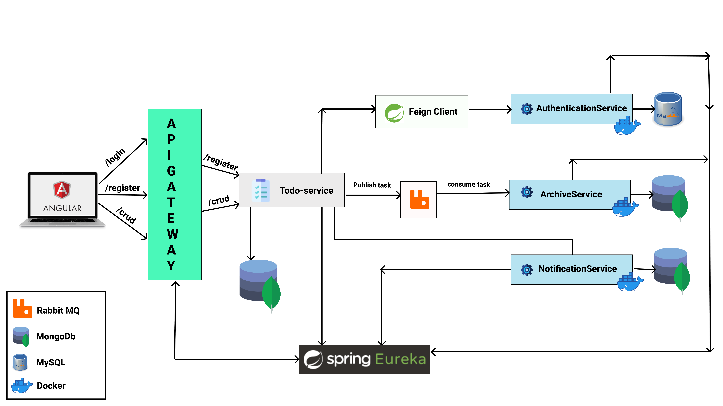
Architecture Diagram

Slide 6
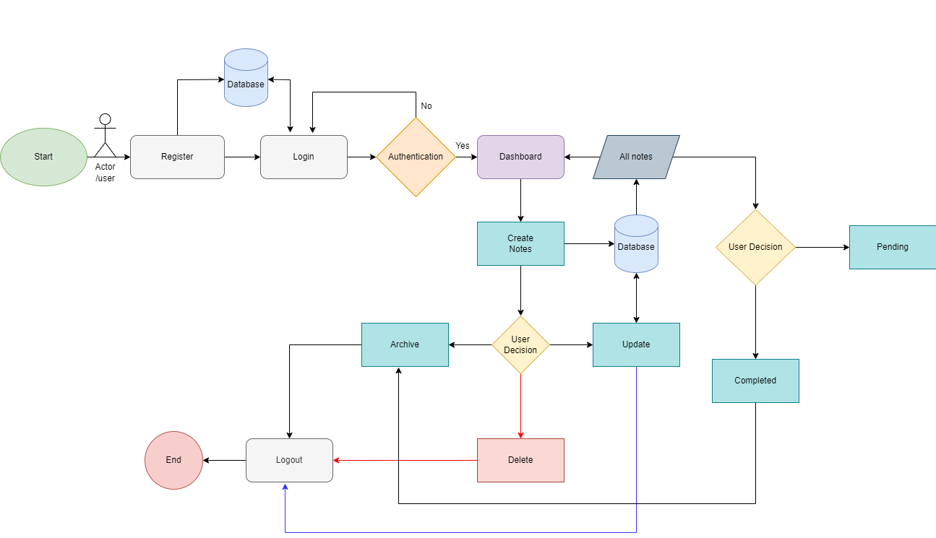
Workflow Diagram

Slide 7
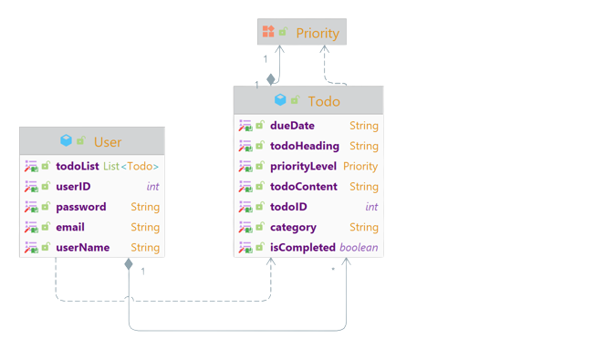
Class Diagram

Slide 8

Application Walkthrough
TO-DO Tracker

Slide 9

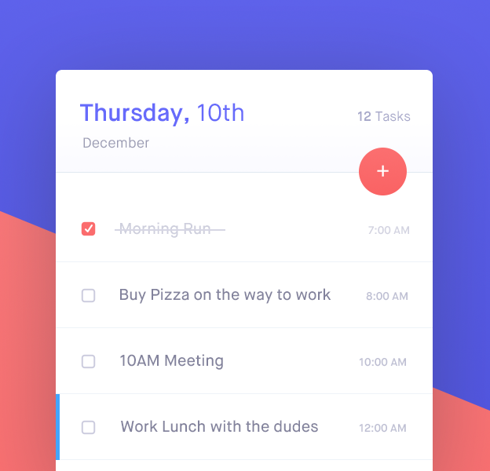
Further improvements
Since we have created this product in 12 days for our initial release, in our later versions , we will incorporate the following enhancements:
Make the UI more enriched.
Forgot password features.
Calendar for tracking to-do date wise.
Share notes to a particular user.
And many more based on feedback.

Slide 10
Thank you
Shashank Malviya
Tamojit Das
Sai Saranya
Mentor: Mr. Rakesh Pandit

